Slide 1


British Airways Review Analysis Report
Sentiment, Topic Modeling & Word Insights
Prepared by: Joel Tamakloe
Date: 8th May, 2025

Slide 2
Introduction
British Airways receives thousands of customer reviews each year, offering valuable insights into passenger experiences.
This analysis leverages natural language processing (NLP) to uncover patterns in sentiment, highlight key areas of praise and concern, and inform data-driven recommendations for enhancing customer satisfaction.

Slide 3
Objective & Scope
Objective: Analyze 1,000 passenger reviews to uncover sentiment trends and thematic insights.
Scope:
Sentiment Classification
Top-Word Frequencies & Word Clouds
Topic Modeling for Key Complaint Themes
Outcome: Provide data-driven recommendations to enhance baggage handling, communication, and in-flight service.

Slide 4
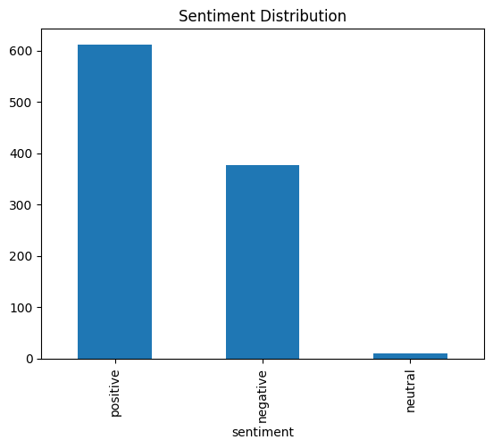
Review Distribution Overview
Total Reviews: 1000
Positive: 612 (61.2%)
Negative: 377 (37.7%)
Neutral: 11 (1.1%)
Highlights:
Majority of reviews are positive indicating customer satisfaction.
Notable share of negative feedback indicate specified dissatisfaction.
Neutral reviews are minimal but factual.

Slide 5
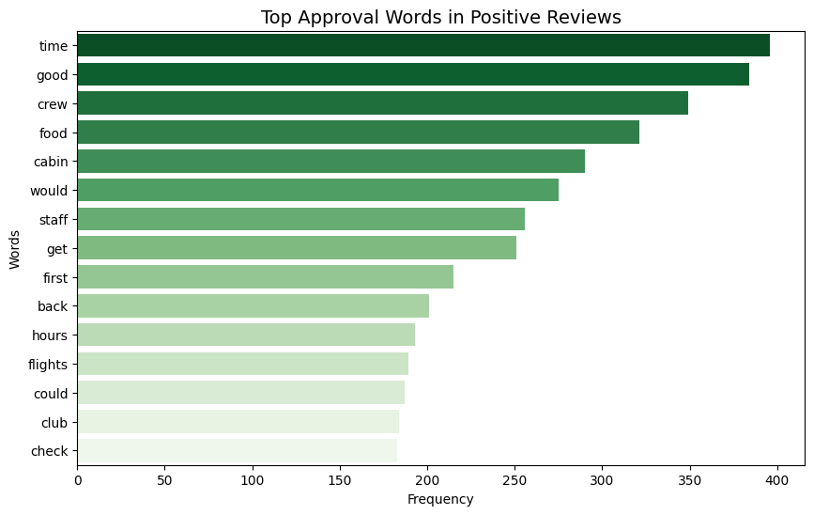
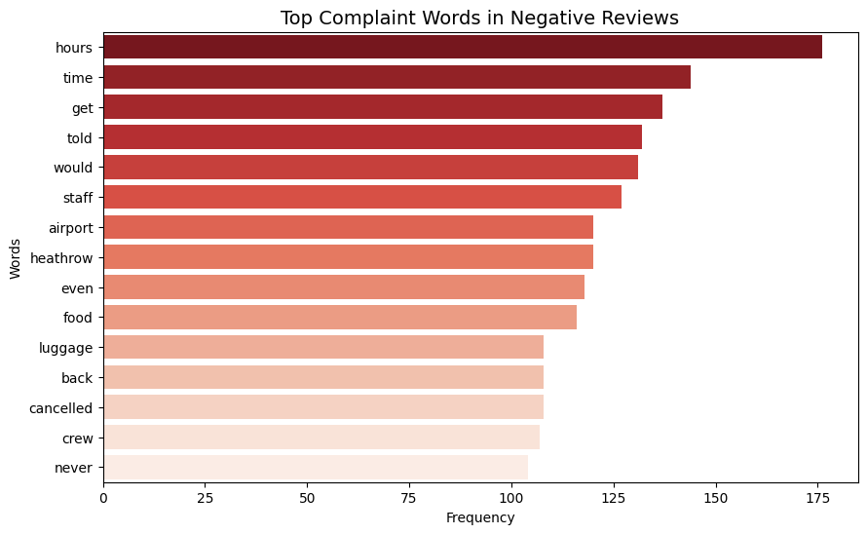
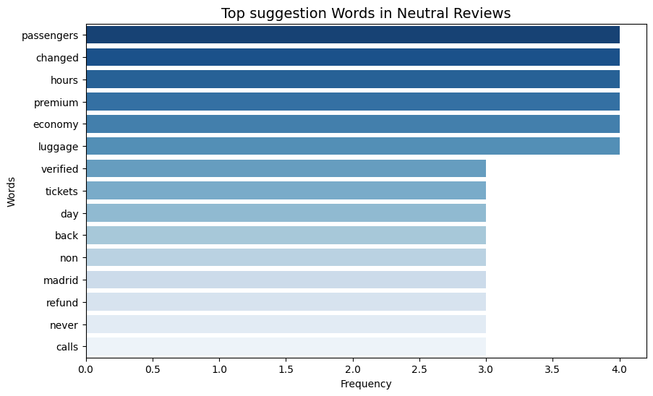
Positive Words
Negative Words
Top Words by Sentiment
Key takeaways
Good feedbacks centers on crew and food quality and time whilst bad feedbacks focus on delays, crew and communication.
Neutral Words

Slide 6
Sentiment Summary
Sentiment | Key Themes | Key Words
Positive | Good crew, food, Club experience | good, crew, food, boarding, experience
Neutral | Seat changes, refunds, premium vs. economy | changed, tickets, premium, economy, refund
Negative | Delays, poor communication, baggage issues | cancelled, hours, luggage, told, never

Slide 7
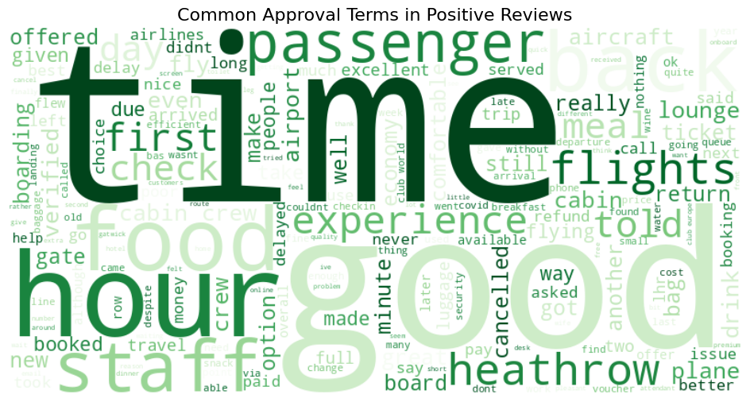
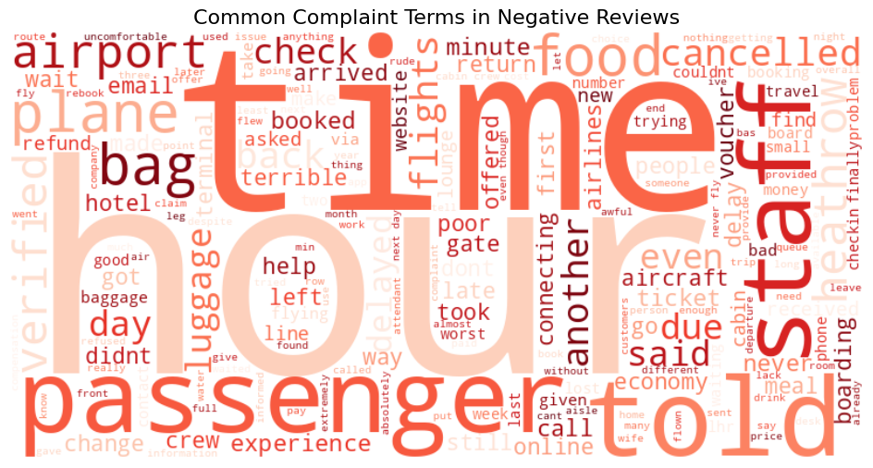
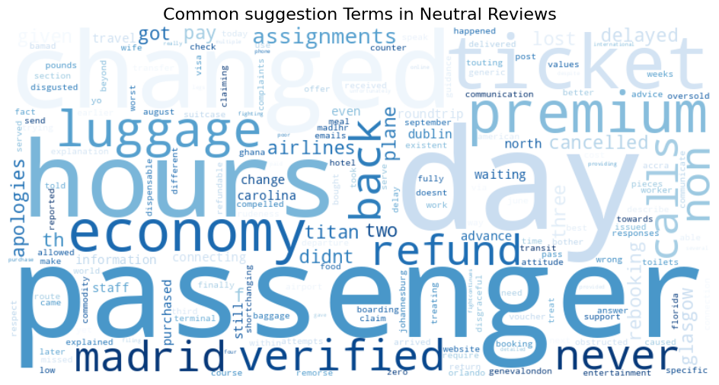
Positive Review
Negative Review
Word Cloud Comparison by Sentiment
Key takeaways
Delays & baggage emerge as the strongest negative themes, while praise centers on crew and food quality
Neutral Review

Slide 8
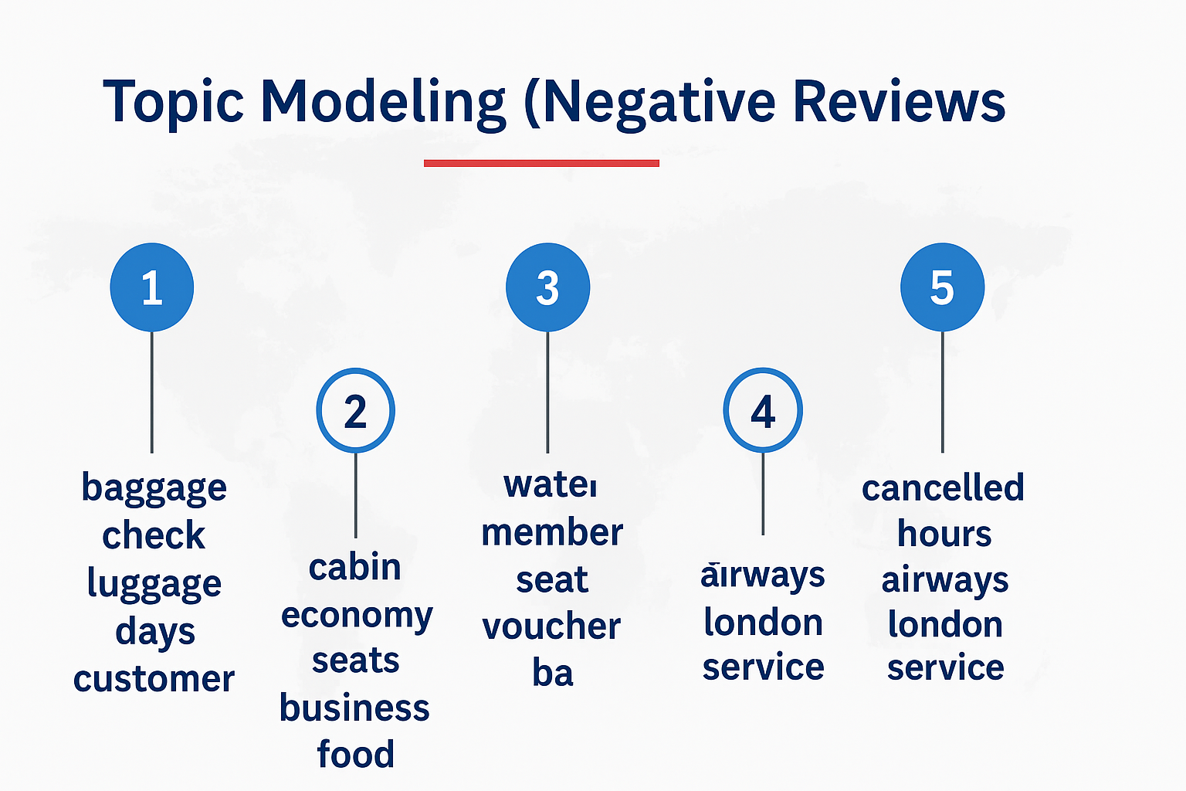
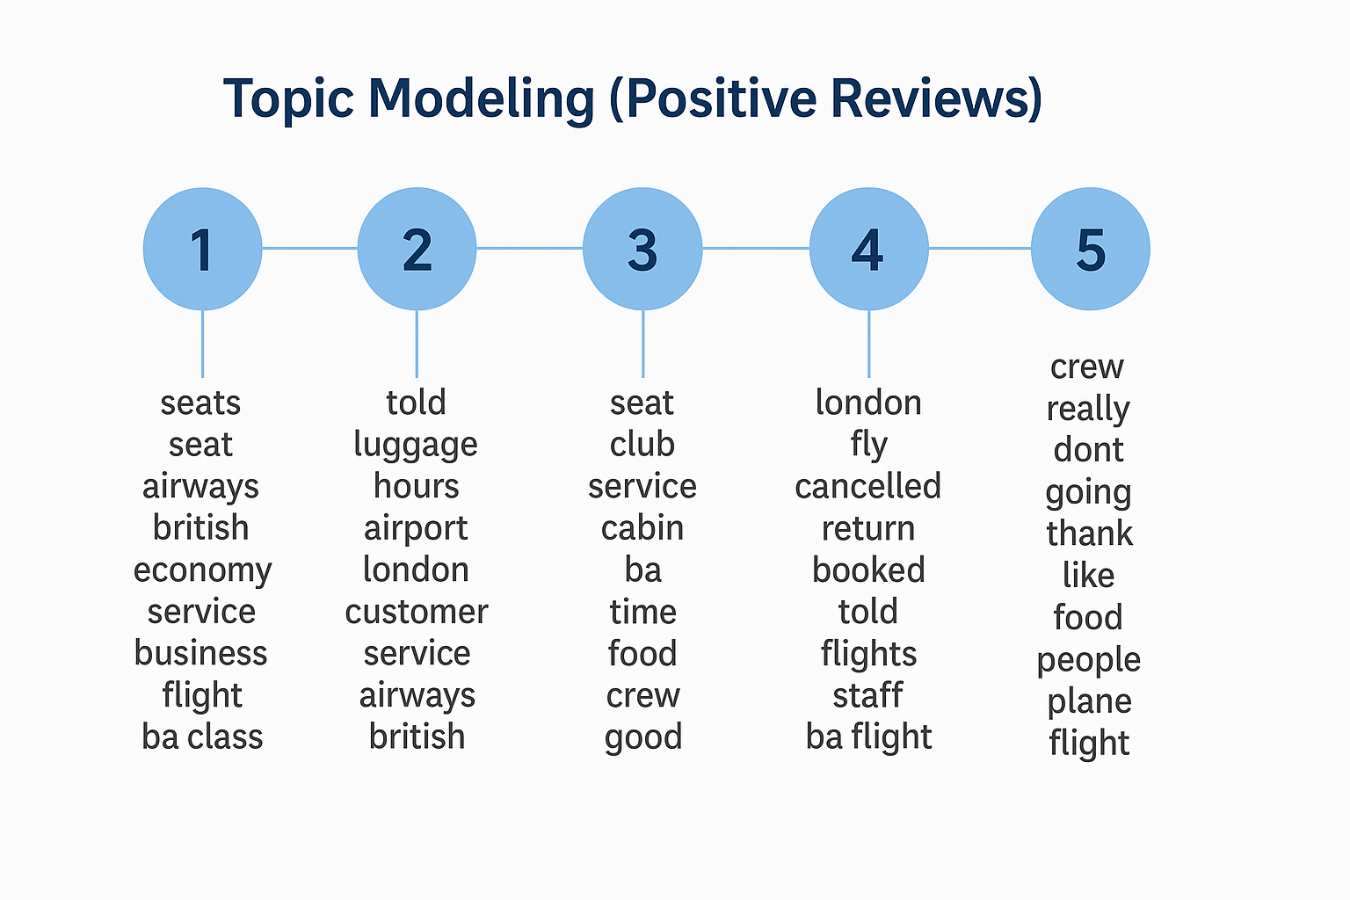
Topic Modeling
Positive topics highlight strong crew service, smooth travel experiences, and high satisfaction with in-flight comfort
Negative Review
Negative topics reflects recurring issues with baggage, delays, cancellations, and inconsistent service experiences.
Positive Review

Slide 9
Operational Implications
Overall Sentiment Balance
Positive reviews dominate, suggesting strong brand loyalty and a generally good experience.
Negative reviews (37.7%) highlight ongoing operational gaps.
Neutral reviews (1.1%) provide objective, factual context.
Sentiment Themes
Positive: Strong service, reliable crew
Negative: Luggage issues, delay frustration
Neutral: Objective statements, minimal emotion

Slide 10
Strategic Recommendations
Leverage Strengths
Maintain and invest in what’s working well: crew service, Club class, and food quality.
Improve Consistency
Standardize service protocols across all routes to reduce variability in passenger experiences.
Address Chronic Pain Points
Improve baggage handling processes to minimize lost/delayed luggage.
Speed up delay recovery measures and clearly communicate updates to passengers.
Enhance Communication & Transparency
Monitor negative keywords in real time for proactive support intervention.
Elevate Staff Responsiveness
Train frontline staff on rapid complaint resolution, especially during boarding and delays.

Slide 11
Conclusion
The majority of reviews reflect a positive perception of British Airways, especially regarding cabin crew and food service.
Negative reviews consistently point to issues with baggage handling, delays, and communication gaps.
Cloud words and Topic modeling confirmed these trends and helped uncover deeper themes around service consistency and emotional dissatisfaction.
Insights gained support a mix of operational fixes and strategic opportunities to enhance the customer experience.
This analysis lays the foundation for actionable service improvements and long-term customer loyalty

